Slide 1
It's More Than High Contrast: Designing For Users With Low Vision
Presented By:
Jonathan Avila
Chief Accessibility Officer
CSUN 2018 Assistive Technology Conference
March 21, 2018

Slide 2

User Needs
Tap to add subtitle
Low Vision Task Force (LVTF) at W3C’s Web Accessibility Initiative’s (WAI) Accessibility Guidelines (AG) working Group
W3C Accessibility Requirements for People with Low Vision (2016)
“Nothing about us without us”
“One size doesn’t fit all – one size fits one”
All examples educational – not judgmental…
Notes:
Not presenting the Low vision Task force – just myself.

Slide 3

A Diverse Set of Needs
# of people with low vision (stats inconsistent)
1M legally blind, 12M VI, 23.7 vision loss (US -CDC)
246-314M VI worldwide
Growing with aging population
Vision changes over time
Low vision is a spectrum of user needs (may conflict)
Some people need low contrast – others need high
Some users are glare sensitive – others need a lot of light
Some have field loss but normal acuity
May be misunderstood b/c functional vision
Users may or may not be tech savvy or have assistive technology
Notes:
CDC Vision Loss Data
https://www.cdc.gov/healthcommunication/toolstemplates/entertainmented/tips/Blindness.html
2015 National Health Interview Survey,
http://www.afb.org/info/blindness-statistics/adults/facts-and-figures/235#demographics
Number of people with low vision
https://nei.nih.gov/lowvision/content/faq
ENHANCING PUBLIC HEALTH SURVEILLANCE OF VISUAL IMPAIRMENT AND EYE HEALTH IN THE UNITED STATES
https://www.cdc.gov/visionhealth/pdf/surveillance_background.pdf

Slide 4
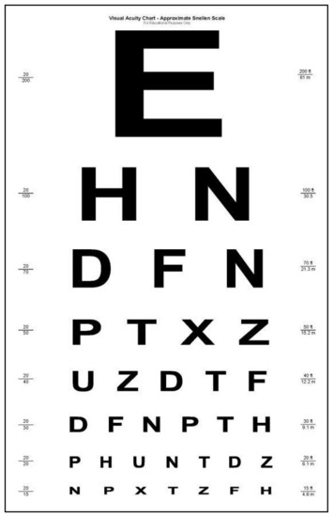
Vision is Not Just Acuity
Making things bigger isn’t enough
Common vision Impairments may include one or more of the following
Visual acuity (clarity)
Light/glare sensitivity
Contrast sensitivity
Limited field of vision
Physical, magnification, or by looking close
Color perception
“Just because I look closely doesn’t mean I can’t see it.”

Slide 5
Methods of Access May Change
​May use keyboard or mouse or touch
Need to support concurrent input methods
May switch between input or switch between
Large text
Magnification/zoom
No access features
Text-to-speech, etc.
Depending on task, time of day, lighting, eye fatigue
Need to support use of multiple modes at once and switching between modes without restarting app/refreshing page

Slide 6
Common Needs
Increased contrast (not just text contrast)
Reduction of glare (e.g. invert colors)
Content that does not rely on color perception
Visual Indication of keyboard Nav focus/Locating Pointer
Locating the pointer (50% of users always or often use KB)¹
Zoom (enlargement)
Legibility ≠ Readability
Reflow of content
Content that can zoom without scrolling in the direction of text
Font changes and text style changes
Font face, spacing, etc.
Proximity of labels/content
Clear identification of structure & interface elements
Notes:
WebAIM Survey of Users with Low Vision
https://webaim.org/projects/lowvisionsurvey/#os

Slide 7
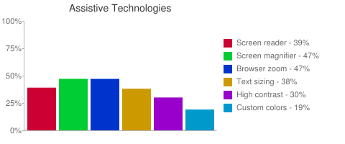
How Users Work Around Issues
Tap to add subtitle
Browser extensions
Stylish document level stylesheets
Increase contrast
Limitations with applying filter
User stylesheets
Browser support is waning
Difficult to find
Stylesheet Problems
Difficult to write
May not be available on mobile
Browser settings for
Zoom
Font changes
Platform Settings
High contrast on Windows
Must be supported by browser
Change resolution
WebAIM Survey of Users with Low Vision (2013)
Notes:
WebAIM Survey of Users with Low Vision
Source: https://webaim.org/projects/lowvisionsurvey/#os
Screen reader 84 39%
Screen magnifier software 102 47%
Browser zoom controls (zooms all page content) 102 47%
Browser text sizing controls (increases only text sizes) 82 38%
High contrast modes 64 30%
Customized page colors or custom style sheets 42 19%

Slide 8
WCAG 2.1 CR
Low-vision related SC in candidate recommendation (all at Level AA)
1.4.10 Reflow
1.4.11 Non-text Contrast (at risk)
1.4.12 Text Spacing
1.4.13 Content on Hover or Focus
Others may have benefits for users with LV
WCAG 2 CR #2 change to Full Pages
Full pages include variations that are automatically generated for different screen sizes and all must conform unless there is an alternative

Slide 9

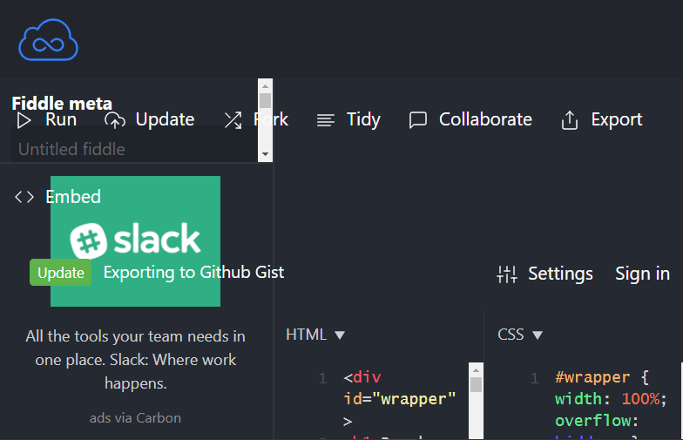
Don’t Break Browser Zoom
It is easier than you think
Myth: SC 1.4.4 Resize is not needed because all pages zoom in the browser
Notes:
https://www.jsfiddle.net

Slide 10
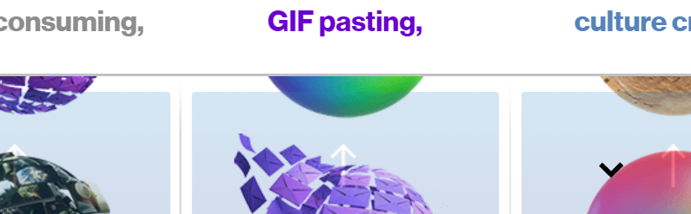
Text Cut-off?
Now what does that say? I’ll have to make it small to see – but then it’s too small to read!
Notes:
Sample from: https://www.oath.com/#perfect-match. Accessed 3/19/18.

Slide 11
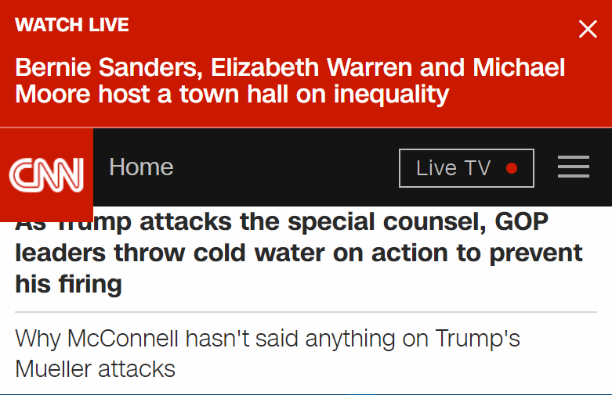
Fixed Header
Good thing they have a close button!
Notes:
http://www.cnn.com

Slide 12
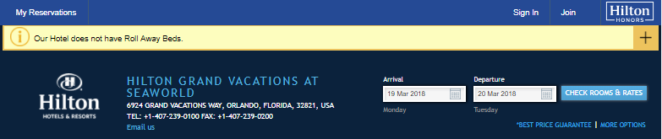
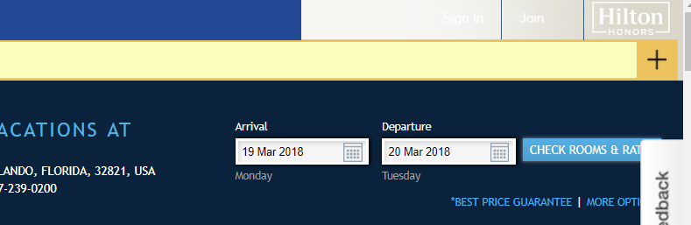
Changes in Contrast with Zoom
Notes:
http://www3.hilton.com/en/hotels/florida/hilton-grand-vacations-at-seaworld-ORLSWGV/attractions/seaworld.html

Slide 13
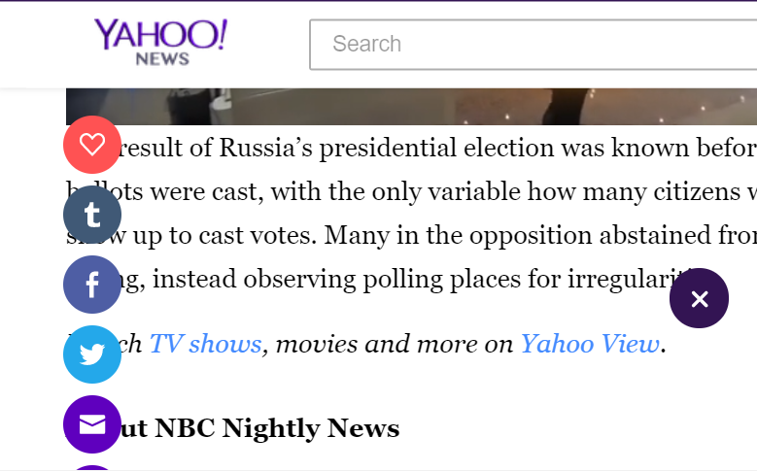
Pesky Icons Over my Article!
Notes:
https://www.yahoo.com/news/m/00d6850b-7c4f-3c3f-aa95-212ee9061b98/russia%3A-five-reasons-why.html

Slide 14
Breaking Browser Zoom
Other Examples that break
Snap to scrolling
Can’t settle screen on text that is cut
Overlapping text
vw/vh units – Use this if you want to block zoom!!
Block or repurpose the scroll wheel on the mouse
Content that gets smaller as you zoom in
Mobile sites that lock viewport user scaling
Google Accelerated Mobile pages that use frames and block scrolling when pinch zoom is used

Slide 15
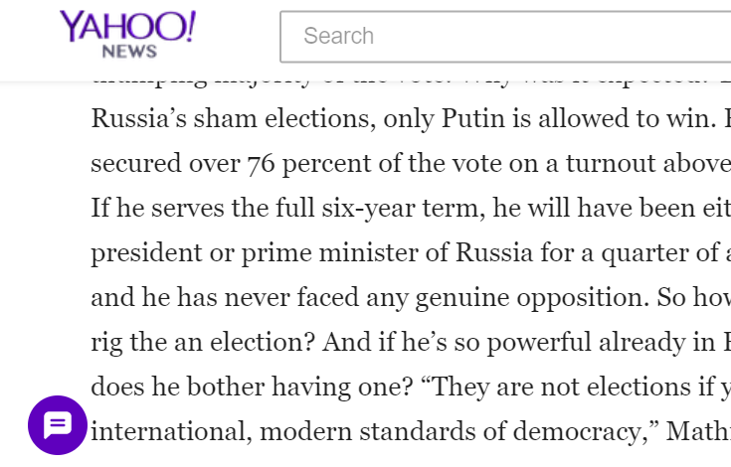
Support Reflow
You are getting sleepy…….
Zoom with scroll back and forth reduces reading efficiency and causes fatigue
Notes:
https://www.yahoo.com/news/m/00d6850b-7c4f-3c3f-aa95-212ee9061b98/russia%3A-five-reasons-why.html

Slide 16
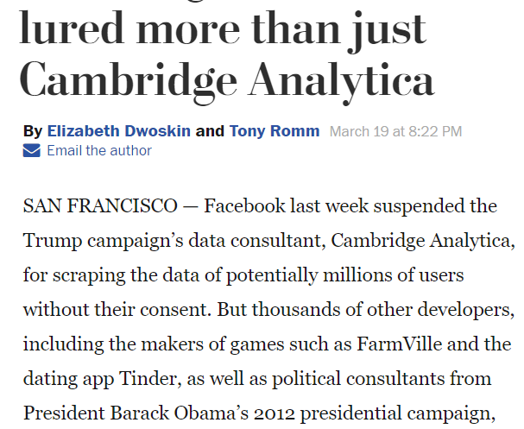
Responsive Design Saves the Day
Look Ma! No horizontal scrolling!
Responsive design using fluid/em/flexgrid content
Zoom on desktop triggers responsive breakpoints
Zoom will increase scale and change viewport width between breakpoints- that’s why a fluid based approach is needed with media queries.
Exceptions – tables, graphics, video, etc.
Notes:
https://www.washingtonpost.com/business/economy/facebooks-rules-for-accessing-user-data-lured-more-than-just-cambridge-analytica/2018/03/19/31f6979c-658e-43d6-a71f-afdd8bf1308b_story.html?utm_term=.b78c49896882

Slide 17



Non-Text Contrast
Controls
Focus Indicator
Border/bounds
State
Exceptions
Disabled controls
No border is required if there isn’t one.

Slide 18
Non-Text Contrast (cont.)
Clear Indication of KB Focus
WCAG 2.0 only required Focus be Visible
Browsers implement focus indicator differently
Custom CSS indicators can be used
Indicators may appear on different combinations of backgrounds
Can create double border like VoiceOver that is black and white and thus has sufficient contrast with itself in all situations
Indication can be background change, border, change, or other visual changes
Size or border may make difference

Slide 19


Non-Text Contrast - Graphics
Graphics/Icons
3:1 contrast of meaningful portions of the graphic

Slide 20
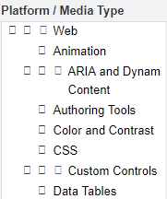
Text Spacing & Font Changes
WCAG 2.1 focuses Text Spacing
General things that affect many
Bold, italics, or all caps may be difficult to read
Sufficient margins around text
Icon fonts
May become unreadable when fonts are replaced
Alternatives may include SVG or marking icons for exclusion from user style changes
Users Needs may conflict - make content adaptable
Spacing around, word, lines, paragraphs
Changing of font faces or styles like serifs may be difficult for some
For justification, increase/decrease margin/borders
Where did the checkboxes go?

Slide 21
Text Spacing
SC 2.4.12
Line height (line spacing) to at least 1.5 times the font size;
Spacing following paragraphs to at least 2 times the font size;
Letter spacing (tracking) to at least 0.12 times the font size;
Word spacing to at least 0.16 times the font size.
* Plug-in or Stylish style can be used
Notes:
https://www.w3.org/WAI/GL/wiki/Allowing_for_Spacing_Override#Alternate_Plugin_Procedure_.28for_Sites_with_Content_Security_Policies.29

Slide 22
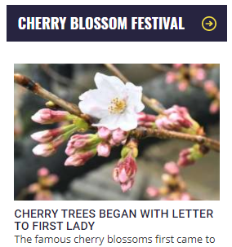

Text Spacing Applied
Before
After
Notes:
https://wtop.com/

Slide 23
Content on Hover or Focus
Problems:
Pop-up can obscure what you are reading
Pop-ups may close when you move mouse to read pop-up content that is scrolled off screen
Pop-up may not fit in magnified area
Solutions:
Dismissible without moving keyboard focus or mouse
Hoverable – can move pointer to content triggered by hover
Persistent - until trigger removed, user dismisses or no longer valid

Slide 24
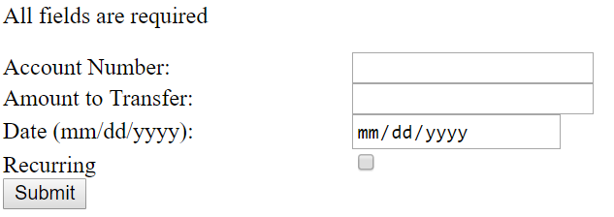
Proximity of Labels and Controls
Labels that are too far away or in the wrong place
Rivers of white with spread-out information

Slide 25
Gaming/VR/Other Considerations
Depth perception for VR/AR/mixed reality
Users may only have use of one eye or eyes may not work together
Visual latency
Speed of locating content
Eye tracking technology may be difficult or impossible if you have nystagmus
Changes from light to dark may be difficult or painful
Moving and giggling content may disrupt eye tracking when reading
CAPTCHAs are problematic
Images of Text

Slide 26
Controls for Changing Text Size/Contrast?
Debated topic
Preferred by those who may not be aware of browser settings/accessibility features
Maybe needed in certain locked-down environments
Better options
Education users such as on BBC
User preferences that follow-up user - future
Site should be designed to be adaptable allowing these changes no matter how the changes are made

Slide 27
Resources
WebAIM Survey of Users with Low vision (2013)
https://webaim.org/projects/lowvisionsurvey/
W3C Accessibility Requirements for People with Low Vision (first public working draft 2016)
https://www.w3.org/TR/low-vision-needs/
Low Vision Accessibility Task Force (LVTF)
https://www.w3.org/WAI/GL/low-vision-a11y-tf/
Low Vision Simulator for Chrome – No Coffee
https://chrome.google.com/webstore/detail/nocoffee/jjeeggmbnhckmgdhmgdckeigabjfbddl?hl=en-US

Slide 28





Thank You
Contact Us
Jonathan Avila
Jon.Avila@LevelAccess.com
Follow Us
@LevelAccessA11y
Level-Access
Level Access
Level Access Blog
Slide Deck Available for Download at: https://www.levelaccess.com/csun18/

